Slide 1

PRESENTATION ON
STAKEHOLDER INTELLIGENCE AND PERFORMANCE DASHBOARD
Presented by :-
Swetalana Parida

Slide 2
INTRODUCTION
The Stakeholder Intelligence and Performance Dashboard is an interactive Tableau-based tool designed to help organizations understand how various stakeholders contribute to overall business performance.
.
It provides insights into:
Stakeholder-wise value creation and contribution
Trends in premium collection and policy behavior
Key financial metrics like profitability, cost ratios, and asset distribution
Data segmented by location, demographics, and policy details
The dashboard transforms raw data into simple visuals, enabling users to explore patterns, compare results, and make informed data-driven decisions.

Slide 3
PROJECT OVERVIEW
DESCRIPTION
The “Financial record dataset” is a comprehensive collection of data that provides valuable insights into the performance and operations of a business over time. This dataset is typically used for analytical and decision-making purposes, allowing businesses, analysts, and stakeholders to explore various aspects of financial activity, stakeholder contributions, and policy performance.
This project addresses the gap in stakeholder performance tracking by offering a visual solution that replaces static reports with interactive analysis.
It brings all key data points into one place, enabling better monitoring, comparison, and decision-making.

Slide 4
PROBLEM STATEMENT
In many organizations, stakeholder-related data is often spread across static reports and spreadsheets, making it hard to understand who is contributing the most, where the profits are coming from, or how premiums and risks are evolving.
Without a centralized and interactive tool, it's difficult for decision-makers to explore trends, compare performance, or gain meaningful insights.
The available financial report dataset contains rich information, but in its raw form, it's not easy to analyze or act on.
This project addresses that gap by transforming the data into a simple, visual dashboard that helps users filter, explore, and understand key business metrics at a glance, enabling smarter, faster, and more confident decisions.

Slide 5
APPROACH
Tools Used:
Tableau (for dashboard creation)
Excel (.xlsx) as the data source
Steps Followed:
Cleaned and prepared the dataset (removed nulls, formatted columns)
Built charts, KPIs, and filters in Tableau
Added dynamic filters for city, gender, date, risk-level, stakeholder, premium, profitability and AUM.
Enabled tooltips, click-based filtering, and PDF export
Implemented a smart insight feature: When a city is selected, the dashboard auto-displays insights like top-performing stakeholders, premium trends, and profitability -reducing manual analysis time
Added YoY premium trend tooltip: Shows % change year-over-year with ↑/↓ arrows and highlights shifts post-2020 (e.g., COVID-19 impact)
Designed for clarity, speed, and role-based user access.
Outcome: A user-friendly dashboard that transforms raw data into accurate, city-based insights and yearly trends - helping users make faster, data-backed business decisions.

Slide 6
REQUIREMENTS
CHARTS AND VISUALIZATIONS
Compare the total value created by different insurers.
Display trends in premiums collected over time.
Showcase the distribution of shareholding patterns among stakeholders.
Analyse the relationship between cost ratio and profitability.
Visualize profitability for different cities and policy tenure durations.
Classify stakeholders as High, Medium, or Low risk using profitability and cost ratio.
Represent the distribution of assets under management across stakeholders.
KEY PERFORMANCE INDICATORS (KPIs)
Display the total premium collected
Show the average age of stakeholders
Highlight the total Value Created for insurers or stakeholders where Assets under Management is 'Equity,'
Identify the highest value created by a single insurer.

Slide 7
KEY FEATURES
Smart City-Based Insight Generates an auto-summary of key metrics when one city is selected (e.g., top stakeholder, insurer, asset class, risk level, etc.).
Stakeholder Risk Profiling Classifies stakeholders as High, Medium, or Low risk using profitability and cost ratio logic.
YoY Premium Trend Tooltip Displays yearly change in premium count using “↑ / ↓ / ↔” symbols, with special context for shifts after 2020 (e.g., COVID-19 impact).
Interactive Filters Enables data exploration by city, gender, tenure, stakeholder, date, etc., and is responsive to filter selections.
Export & Access Supports PDF export with watermark and designed with role-based access in mind.

Slide 8
ADVANTAGES AND LIMITATIONS
Advantages-
Generates smart, city-based insights for quick understanding.
Year-over-year trend tooltip adds context to premium changes, especially after 2020.
Classifies stakeholder risk to support strategic decisions.
Interactive filters improve data exploration and usability.
Limitations-
Based on static .xlsx file; not connected to live data.
AI insight only works when one city is selected.
Role-based access is conceptually included but not enforced.

Slide 9
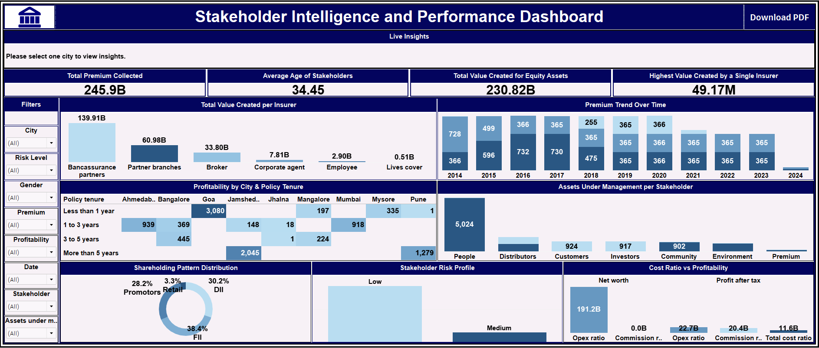
DEFAULT DASHBOARD VIEW - Initial view with all filters available and summary KPIs visible.

Slide 10
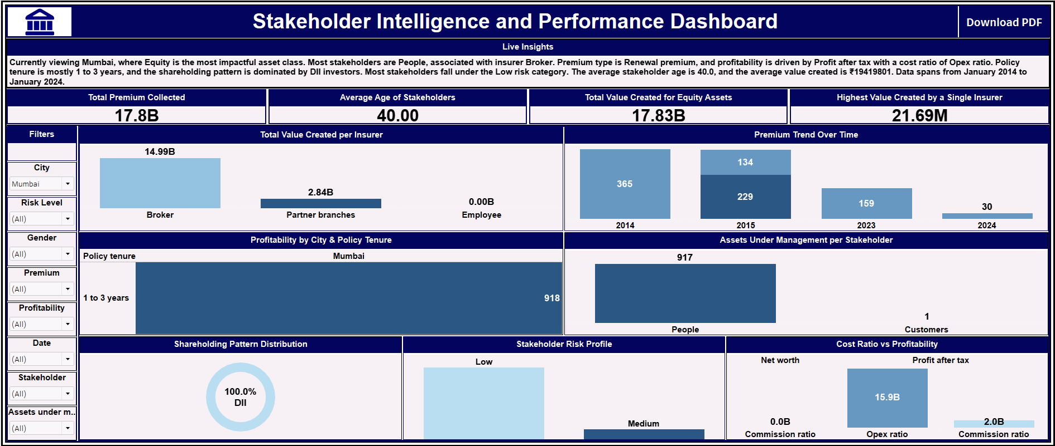
AFTER SELECTING A CITY - City-based AI insight is triggered - showing key metrics like top stakeholder, asset class, risk level, etc.

Slide 11
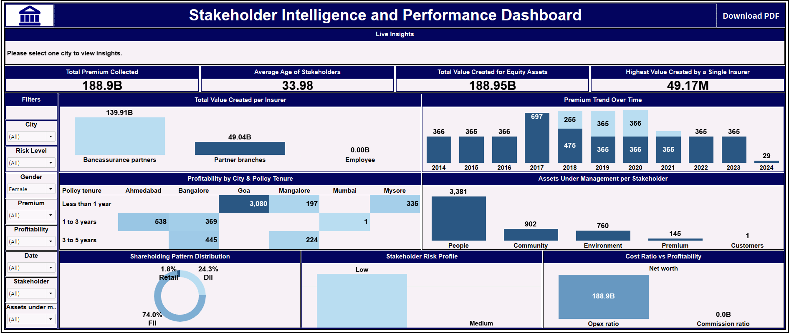
AFTER APPLYING ADDITIONAL FILTERS - Charts and KPIs respond to filters like gender, date, etc. enabling deeper analysis.

Slide 12
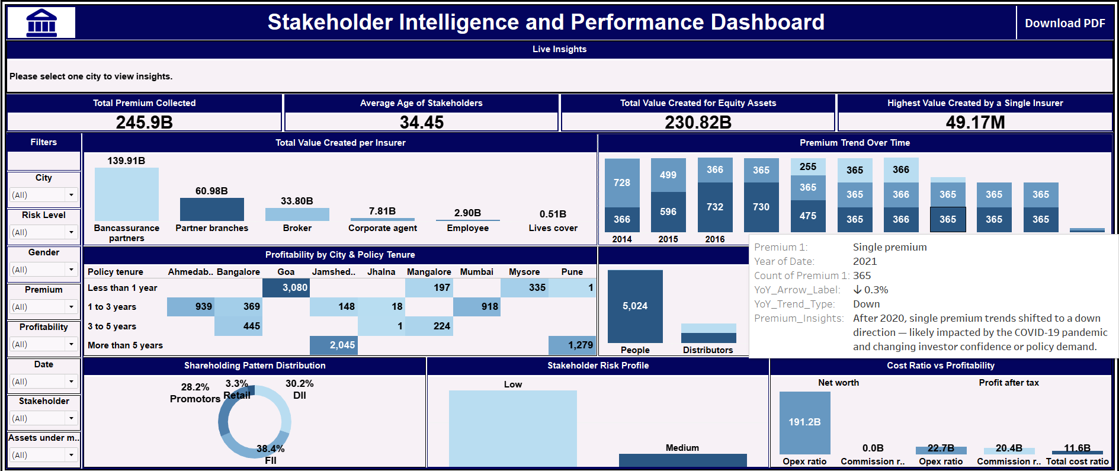
ON HOVERING OVER PREMIUM TRENDS- Tooltip shows year-over-year change (↑ / ↓ / ↔) and highlights shifts after 2020 for quick, contextual insights.

Slide 13
RECOMMENDATIONS
In Jhalna (3–5 year policies) and Pune (less than 1 year), profits are very low - only 1 profitable case each. Meanwhile, Goa performs strongly with 3,080 profitable short-term policies. It’s better to focus on short-term policies in Goa and rework the policy strategy in Jhalna and Pune for better results.
Banks are helping the company earn the most. Bancassurance partners (banks selling policies) are bringing in the highest value. We should build even stronger ties with them to keep profits growing.
Most of the money is being handled by people. There are way more people managing assets (5,024) than investors or customers. We should focus more on this group — maybe offer them special plans or rewards.
Foreign investors own the biggest share. FIIs (investors from outside the country) have invested the most. Keeping them happy and informed can help the business stay strong in the long run.

Slide 14
No money is being spent on commissions. The company isn’t paying agents or brokers any commission, but it is spending a lot on operations. We can save even more money by pushing online sales or direct channels.
The company is rich but not earning as much profit. It has a huge value (191.2B), but much lower final profit (20.4B). That means there’s room to reduce costs or increase earnings to improve profits.
Premium collection hasn’t grown since 2019. From 2020 to 2023, it has stayed flat. But for 2024, it suddenly dropped. It’s time to bring new policy types or smart offers to attract more people.
Most customers are low-risk. Very few fall into the risky category. That’s great! We can confidently offer them premium or long-term plans - they’re more likely to buy and stay.

Slide 15
CONCLUSION
This dashboard makes it easy to understand complex business data, like who’s contributing the most, where profits are coming from, and how different policies are performing.
It helps users get clear insights with just a few clicks, without needing to dig through rows of numbers.
By using Tableau and a structured Excel dataset, I built a solution that’s simple, interactive, and useful for better decision-making.
A tooltip feature was also added to show year-over-year premium changes and highlight trend shifts after 2020, giving users quick context directly within the chart.
All dashboard outputs were cross-checked with Excel data to ensure error-free insights.

Slide 16
INSTALLATION STEPS
1. Install Tableau Desktop or Tableau Public Download and install from: https://www.tableau.com
2. Download the Dashboard File (.twbx) Place the .twbx file and the dataset (.xlsx) in the same folder.
3. Open the Dashboard Use Tableau to open the .twbx file.
4. Explore the Dashboard Use filters like city, gender, tenure, etc. ➡ AI insight appears when one city is selected.
➡ Hover over premium trends to see YoY change with ↑ / ↓ / ↔ and highlights after 2020.
5. Export Insights Click on File > Export as PDF to generate reports.
📝 For detailed instructions, please refer to the attached User Guide document.

Slide 17
THANK YOU

